Slide 1
Spike Sorting

Slide 2
Team Members
Yinli Liu
Xuguang Qi
Mahsa Zahery

Slide 3
Plan
Our team will utilize course book and any resources available through internet to gather the references containing Data Mining information.
Due to distance and travel issues, we agreed to divide the work, communicate through e-mail and meet at least once a week to complete this project.

Slide 4
Plan
It will be each team member’s responsibility to alert other member’s of any missing or wrong information if present, otherwise he or she will approve the draft for submission as the final product.

Slide 5
Tasks
Each team member was assigned the following tasks:
Xuguang Qi: Algorithm, and Other
Mahsa Zahery: Weka, and Other
Yinli Liu: Weka, and Other

Slide 6
Procedure
1) Choosing proper algorithm
2) Using Weka to deal with the data
3) Validating the results
4) Finishing the report
5) Preparing the presentation

Slide 7
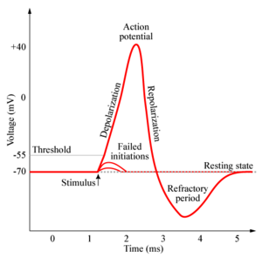
Background
Spike (Action Potential)
self-regenerating wave of electrochemical activity that allows nerve cells to carry a signal over a distance

Slide 8
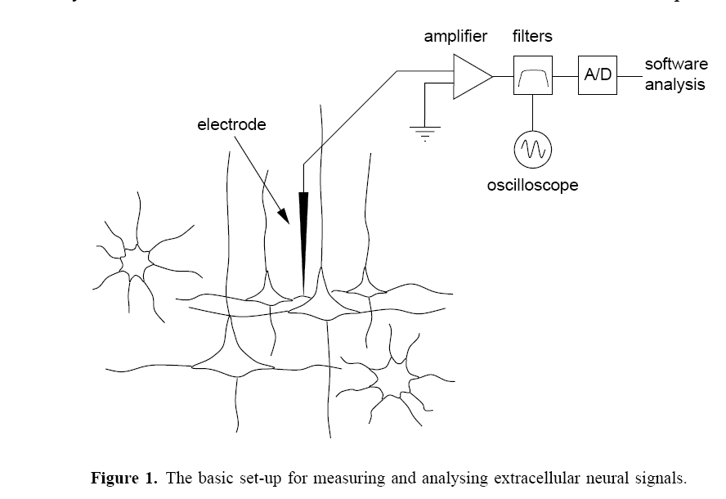
Background
Spike Sorting
Detection and classification process of spikes from extracellular recordings of neurons using electrodes
We need to decide which and how many spikes are present in the collected data

Slide 9
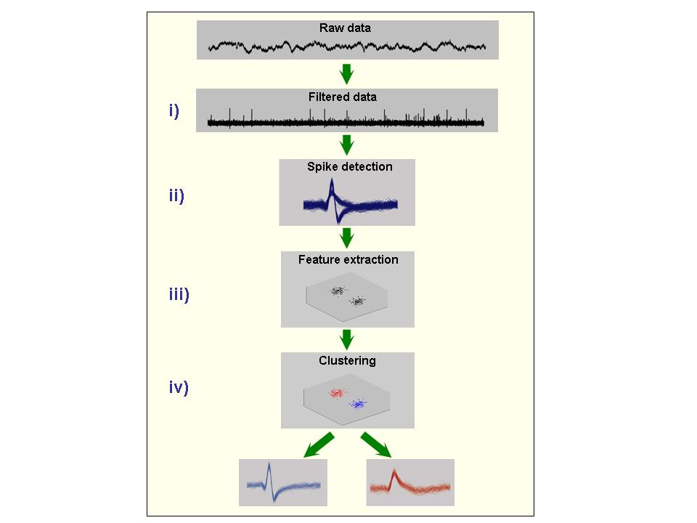
Basic steps for spike sorting
Step i) The continuous raw data is band-pass filtered, e.g. between 300 Hz and 3000 Hz.
For us: four Datasets
Step ii) Spikes are detected, usually using an amplitude threshold.
Other Algorithms (for overlapping)
Step iii) Relevant features of the spike shapes are extracted, thus giving a dimensionality reduction.
PCA(for feature), Bayesian …
Step iv) These features are the input of a clustering algorithm that performs the classification.

Slide 10
Data
4 Datasets
  2 datasets for classification
    65 columns: 64(data) + 1(class information)
    Number of classes: 3(“1”, “2” and ”3”)
  2 datasets for clustering
    64 columns: no column for class information
    Number of classes: not known
  Each dataset has around 3000 rows/spikes

Slide 11
Weka
Weka’s core package
Attribute
Instance
Instances
Data Pre-Processing
Filters

Slide 12
Weka
General manipulation of attributes
Add Filter
Delete Filter
Merge Attribute Values Filter
Nominal To Binary Filter
Select Filter
Replace Missing Values Filter

Slide 13
Weka
Transforming numeric attributes
Discretise Filter
Numeric Transform Filter
Feature Selection
correlation based
Wrapper
Relief

Slide 14
Weka
Learning schemes
ZeroR
IBk
Decision Stump
j48
Additional learning schemes
Association rules
Clustering

Slide 15
THANK YOU!

